Slide 1

Movie Sales Analysis
GROUP MEMBERS:
    1. G. Subba Reddy
    2. T. Venkata Aravind Sai

Slide 2
1. Business Problem & Use Case / Domain Understanding
What to include:
Domain:Entertainment Industry / Movie Sales Analytics.
Business Problem:The movie industry generates vast amounts of data on revenue, ratings, and audience engagement. Understanding trends by year, genre, and ratings supports better production and marketing decisions.
Use Case Examples:
Production Planning: Identify top-performing genres, directors, and actors.
Revenue Forecasting: Predict potential box office success using past trends.
Audience Insights: Analyze ratings and votes to understand viewer preferences.
Marketing Strategy: Optimize promotions based on genre, rating, and release timing.

Slide 3
2. Objective of the Project
Key goals:
To compare different genres and identify which ones perform best in
revenue, IMDb rating.
To evaluate top-performing directors, actors, and movies contributing to overall box office success.
To analyze movie performance trends over the years in terms of releases,
ratings, votes, and box office revenue.
To create an interactive Power BI dashboard that provides actionable insights
for data-driven decision-making in the film industry.

Slide 4
3. Data Importing– Details
Scraped data (Dataset source): Movie Dataset (Given)
Process Followed:
  Collected movie data (ratings, revenue, genre, etc.)
  Store into CSV/Excel.
  Cleaned the data by removing nulls and fixing errors.
  Loaded the data into Power BI for analysis and visualization.
Challenges Faced:
  Missing or incomplete data for some movies.
  Different data formats (dates, numbers, ratings).
  Managing large data and creating correct relationships in Power BI.

Slide 5
4. Summary of the Data
Columns: Rank, Title, Genre, Description, Director, Actors, Year, Runtime (Minutes), Rating, Votes, Revenue (Millions), Metascore.
Size: Rows = around 1,000 movies; Columns = 12.
Date Range: 2006–2016.
Granularity:Each record represents a single movie entry.
Issues:Missing values in revenue and metascore, inconsistent data formats, and duplicate movie titles (fixed during data cleaning).

Slide 6
Exploratory Data Analysis:
Data Cleaning → Removed errors, duplicates, and missing values.
Data Manipulation → Created new fields and organized data.
Univariate Analysis →Studied each column like Rating, Genre, Revenue.
Bivariate Analysis →Checked relationships (e.g., Rating vs Revenue, Genre vs Year).

Slide 7
5. Key Business Questions
Movie Overview & Time Trends
Genre & Rating Analysis
Top Performers & Box Office Insights
Correlation & Advanced Metrics

Slide 8
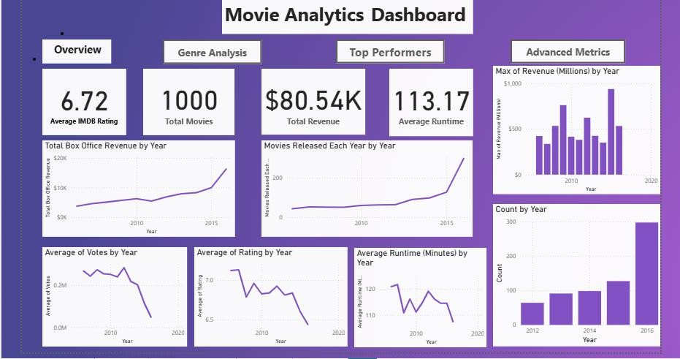


Slide 9
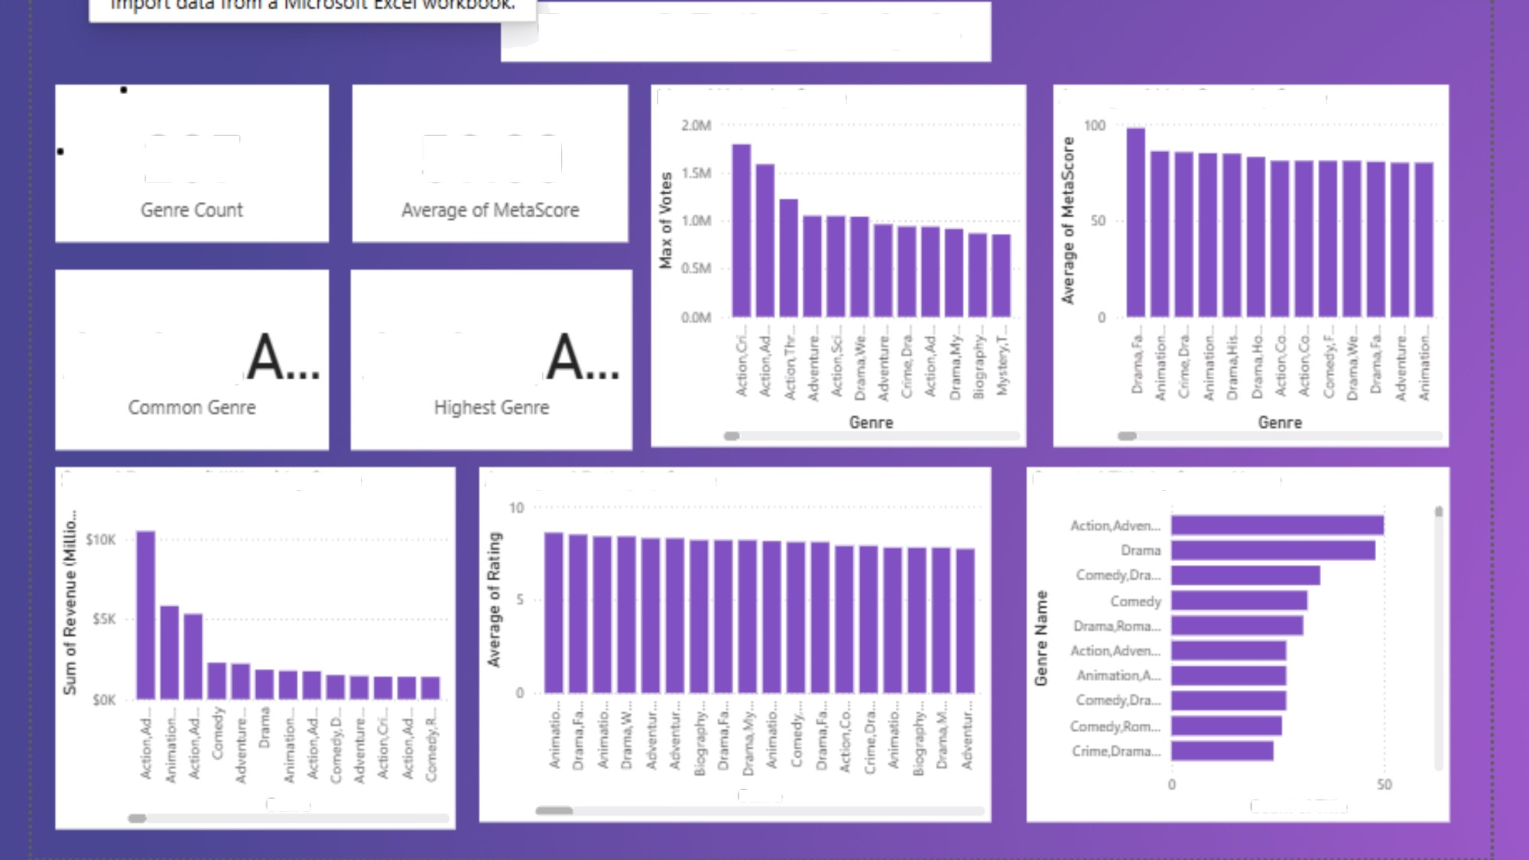
Genre & Rating Analysis
Max of Votes by Genre
Averageo| MetaScorebyGenre
207
59.00
Action,
Action.
Sum of Revenue Millions by Genre
Ax'erage of Rating by Genre
Count of Title by Genre Name
G enre
Genre
Coun° of Tit Ie

Slide 10
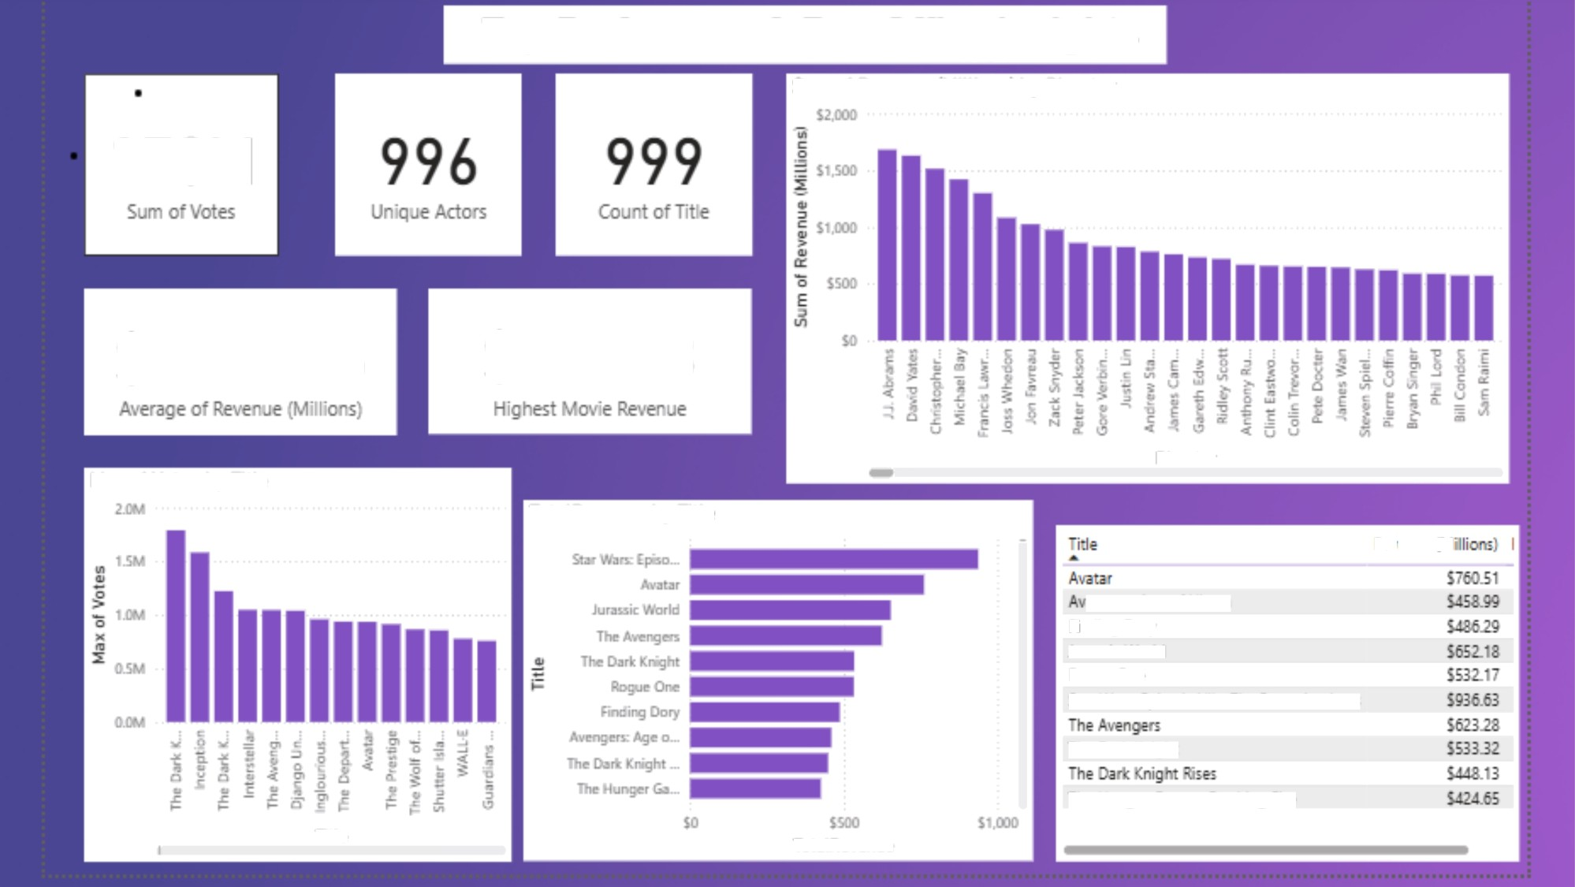
Top Performers & Box OZice Insights
Sum ol Revenue IMillions! by Director
17OM
$80.5446
$936.63
Director
Idax ol Votes by Title
TotalRevenue by Title
Revenue :f•‹1
engers: Age cf Ultron
I›ndir›g psry Jurassic ’Acrld Rcque Cm
Star '‹1'ars: Episode \’I - *he *crce A»akens
the 3ark knight
The -unger Games: Catching *ire
Title
TotatRevenue

Slide 11
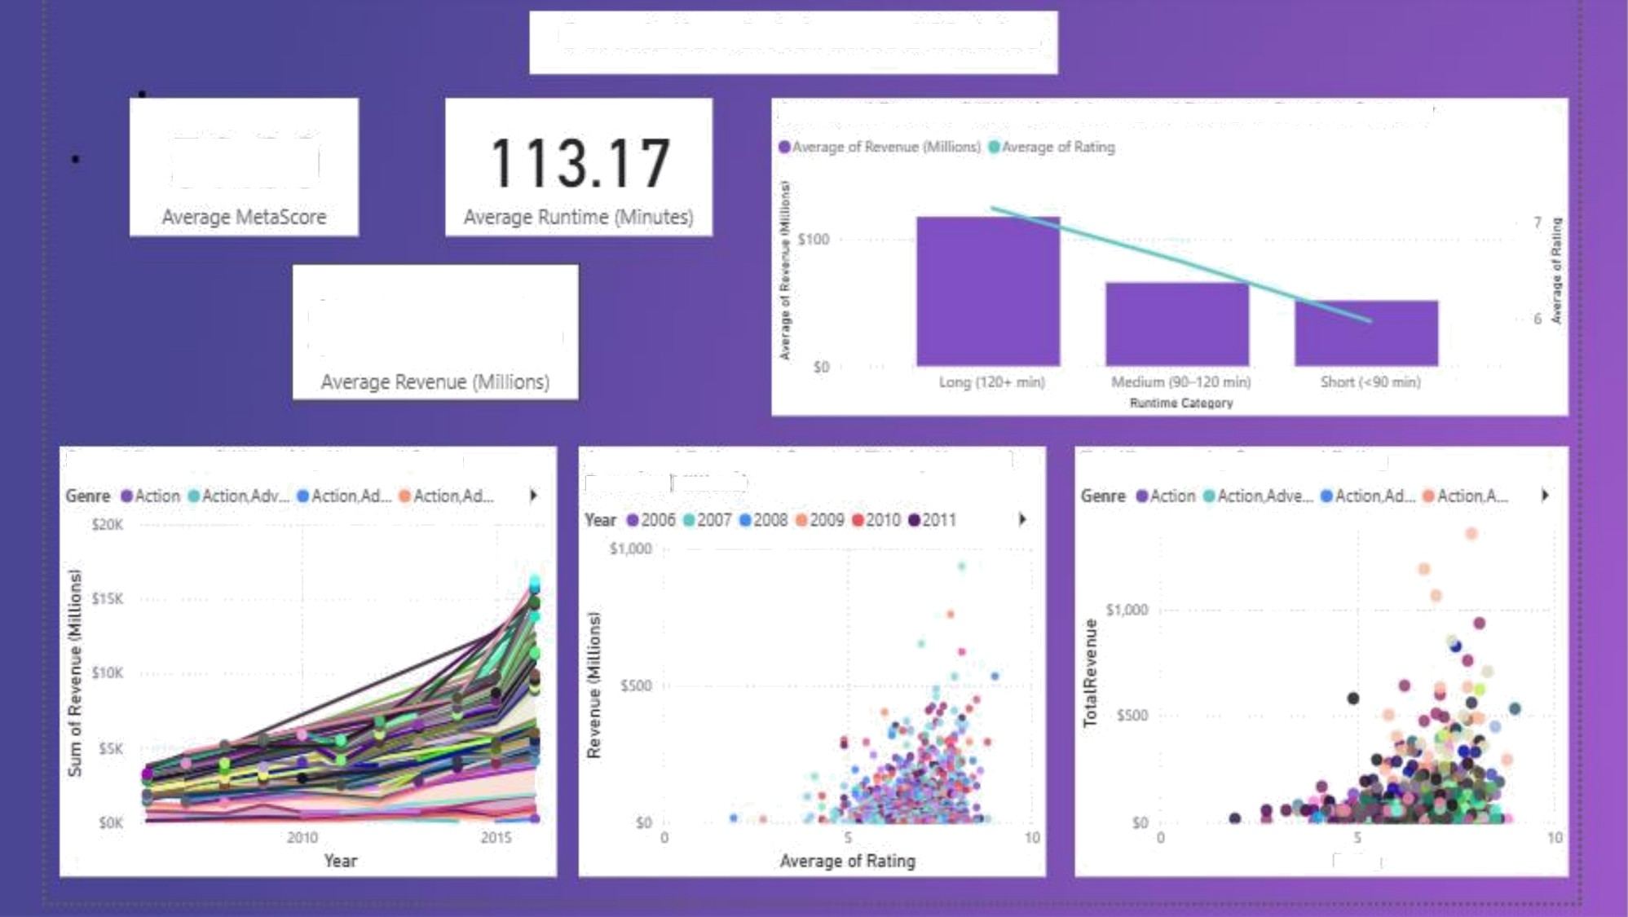

Correlation & Advanced MeVics
As'erage of Revenue IMillions! and Average of Rating b\’ Runtime Categog
59.00
$80.5446
Sum ol Revenue iMillionsi b\’ Year and Genre
As'erage of Rating and Count of Title by Year and Re'zenue klillions
TotalRevenue by Genre and Rating

Slide 12
6. Conclusion
Movie Releases: Certain years had more releases, showing industry
growth trends.
Revenue & Ratings: Top genres and directors drive most of the box office
revenue.
Audience Engagement: Higher IMDb ratings often correlate with higher revenue and votes.
Comparative Analysis: Some genres or directors consistently outperform others.
Overall: Clear insights into trends, top performers, and factors influencing
movie success.

Slide 13

THANK YOU

